Slide 1
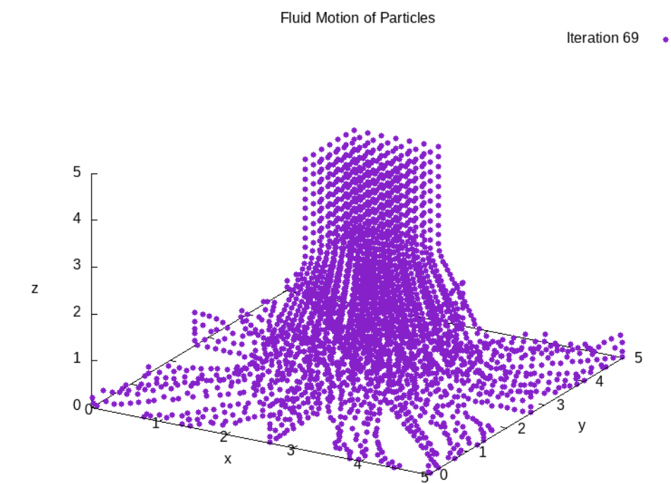
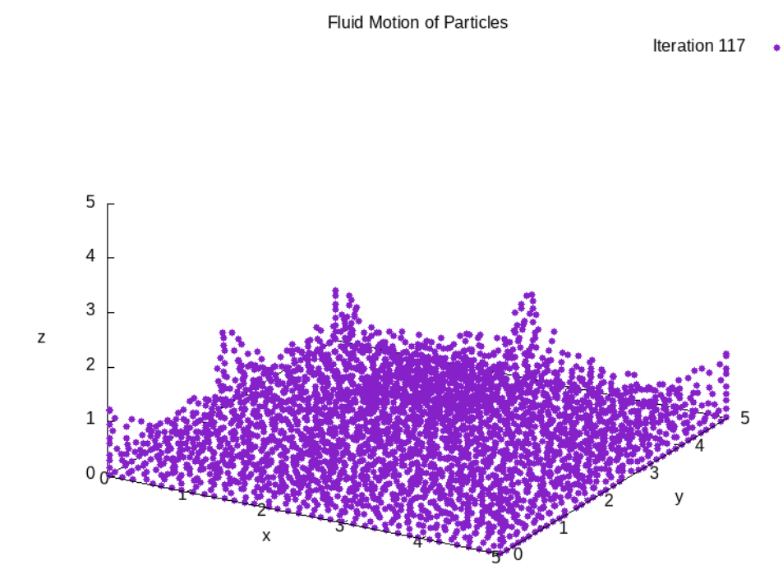
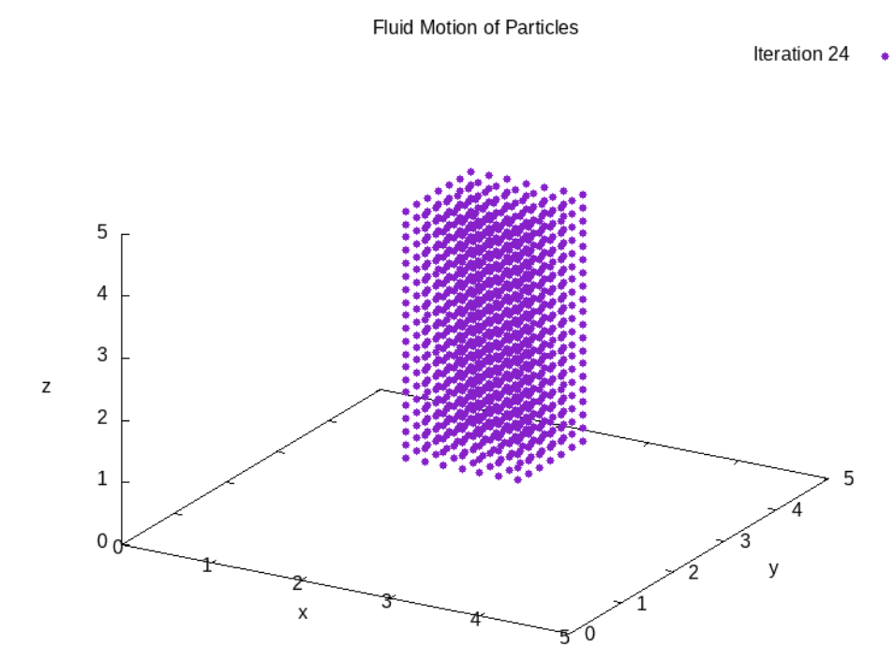
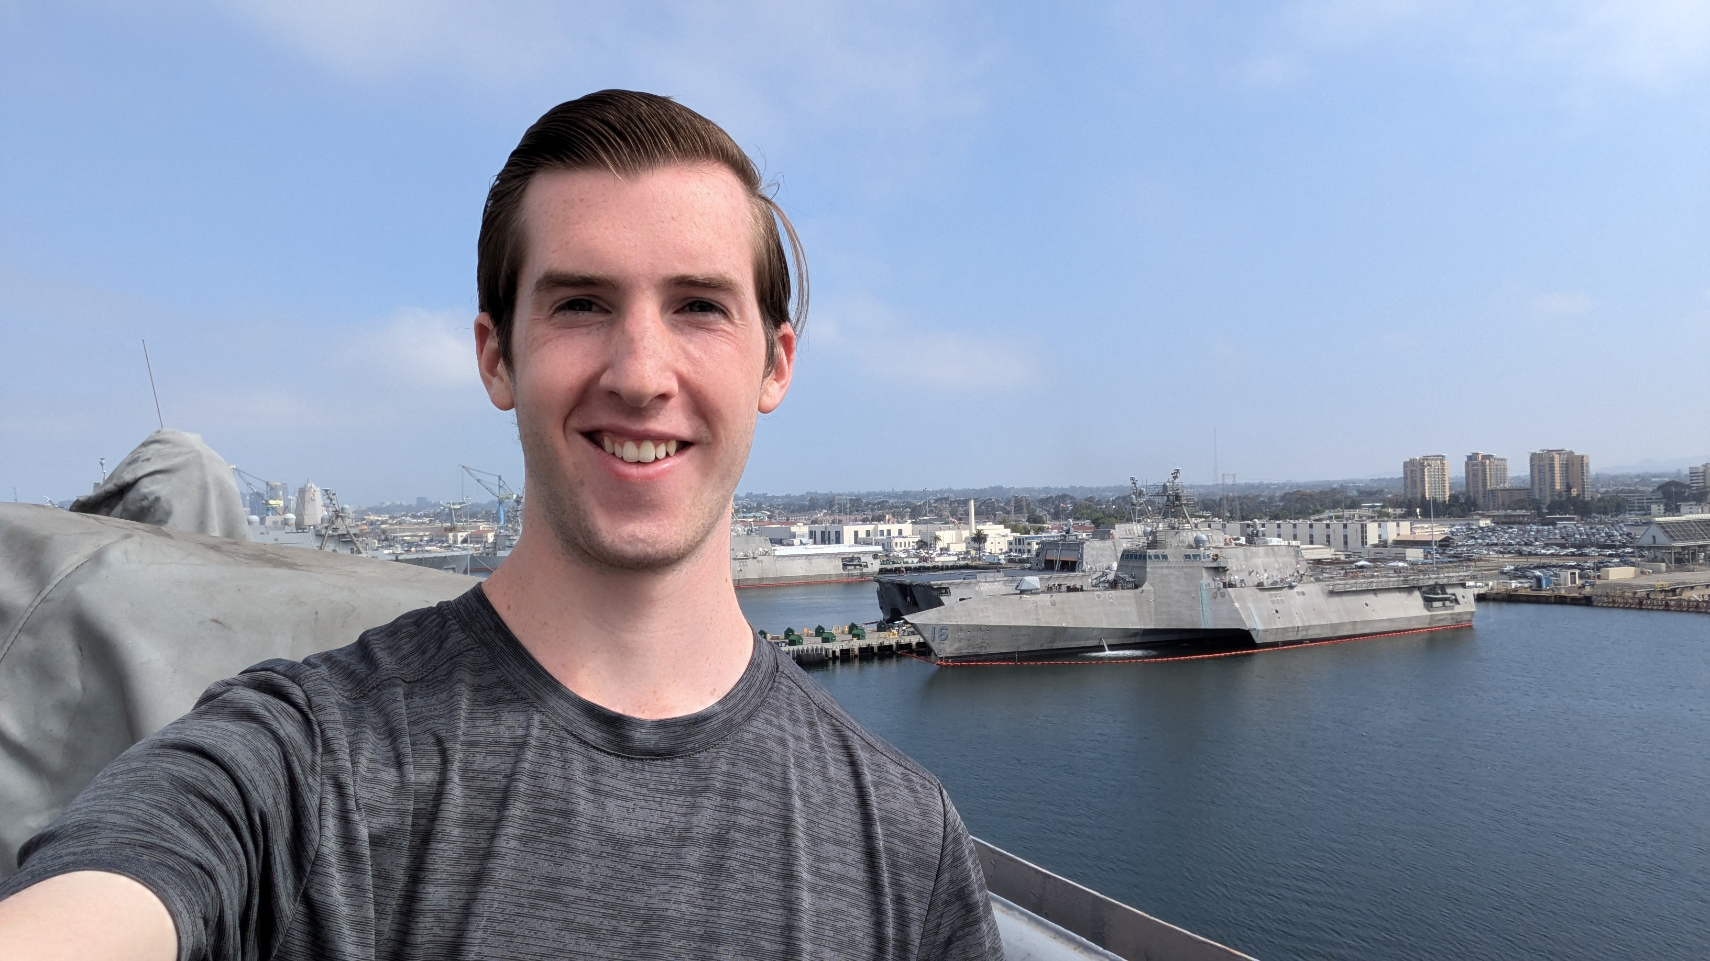
Fluid Mechanics: Smooth Hydrodynamics
PH 385 – Numerical Modeling Physics
Mark Smith
Background
Results
Fluid motion is a complex dynamical system that can be modeled as many particles. There are many approaches to model these particles, but the one that will be employed here is the smoothed particle hydrodynamics (SPH) model. This model uses different functions, called kernels, to discriminate what the different forces are doing to the particles. The forces that can be modeled this way are viscosity, pressure, and surface tension. These all combine to provide attraction and repulsion in an incompressible way to model the fluid of interest.
Initial impact with walls:
After all particles have fallen:
Objective
The goal of this project was to create a simulation of pouring water into a glass and then letting the water settle. To validate the simulation, a visual check was used since seeing water settle is a very common occurrence.
Experimental Design & Methods
This simulation was made in C++ utilizing a 1D vector to increase the speed of the simulation. A class structure was made that housed all the methods needs to run the simulation. The below initial setup was used. All inputs are in arbitrary units.
Discussion/Conclusions
Authors
The frames from the gif produce show that the fluid is behaving as one would expect. There are preferred directions the particles want to flow to, but that is an artifact of the initial rectangular geometry. Different viscosities were also simulated, and those had appropriate buckling as the particles fell faster than they could spread.
Mark Smith
(physics)
References
M. Müller, D. Charypar, and M. Gross, "Particle-based fluid simulation for interactive applications," in Proceedings of the 2003 ACM SIGGRAPH/Eurographics Symposium on Computer Animation (Eurographics Association, 2003), pp. 154–159.
Notes:
BYU-Idaho Logo – The university has specific guidelines on university branding, please do not remove or reduce the logo size. It can be moved.

